Slide 1
Internet of Things Forecast
By: Amanda Harbison

Slide 2
Theory of IOT
“…the idea of embedding connectivity and intelligence in a wide range of devices.”
A New Deal for Buildings, Ron Zimmer
https://newdeal.blog/how-iot-is-transforming-the-hvacr-industry

Slide 3
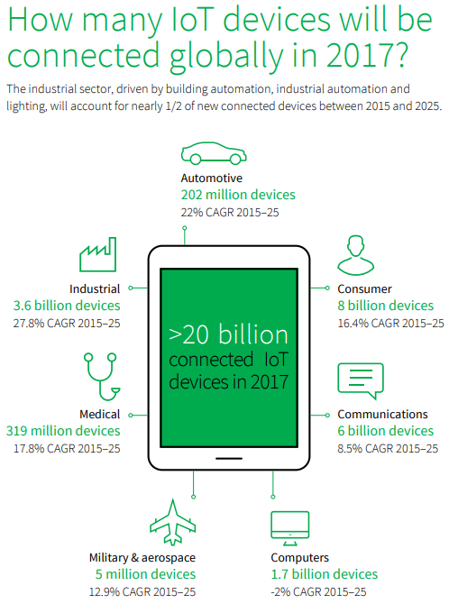
CAGR = Compound Annual Growth Rate
IOT Trend Watch 2017, IHS Markit. https://cdn.ihs.com/www/pdf/IHS-Markit_IoT-trend-watch-2017.pdf

Slide 4
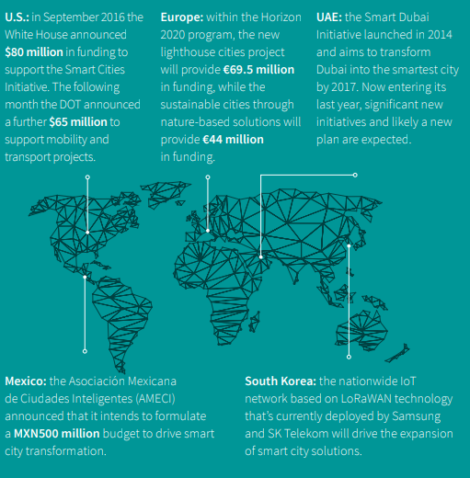
Which governments are using smart city investments to drive economic development?
IOT Trend Watch 2017, IHS Markit. https://cdn.ihs.com/www/pdf/IHS-Markit_IoT-trend-watch-2017.pdf

Slide 5
IOT Market
“The global market for robots and drones will grow to $3.9 billion in 2018.” -IHS Markit forecasts
“…8.4 billion connected things will be in use worldwide in 2017, up 31 percent from 2016, and will reach 20.4 billion by 2020. Total spending on endpoints and services will reach almost $2 trillion in 2017.” - Gartner, Inc. forecasts
“The global installed base of IoT devices will rise from 27 billion in 2017 to 73 billion in 2025…” - IHS Markit forecasts
“…IoT “smart city” initiatives will have an economic impact of up to $1.6 trillion per year by 2025.” -BSA | The Software
Alliance
“By 2020, IoT technology will be in 95% of electronics for new product designs.” - Gartner
“By 2020, Gartner estimates internet-connected things will outnumber humans 4-to-1, creating new dynamics for marketing, sales and customer service.” - Gartner

Slide 6
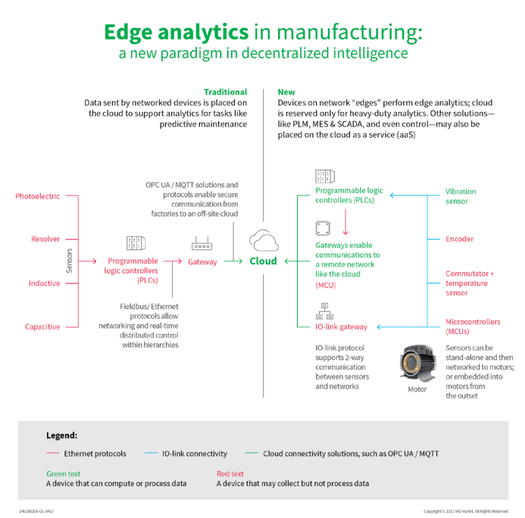
IOT Trend Watch 2017, IHS Markit. https://cdn.ihs.com/www/pdf/IHS-Markit-Cloud-and-edge-analytics.pdf

Slide 8
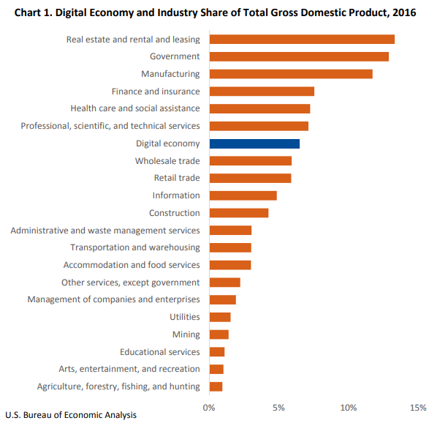

Slide 9
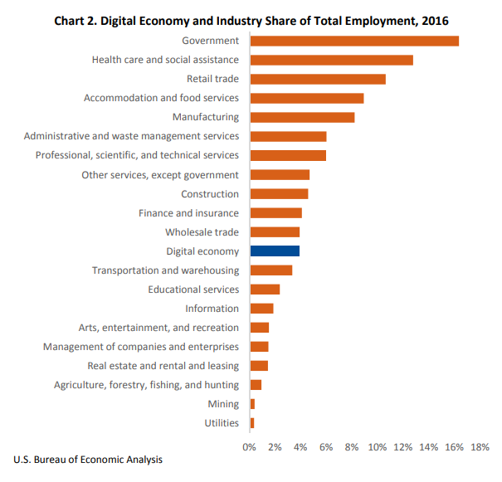

Slide 10
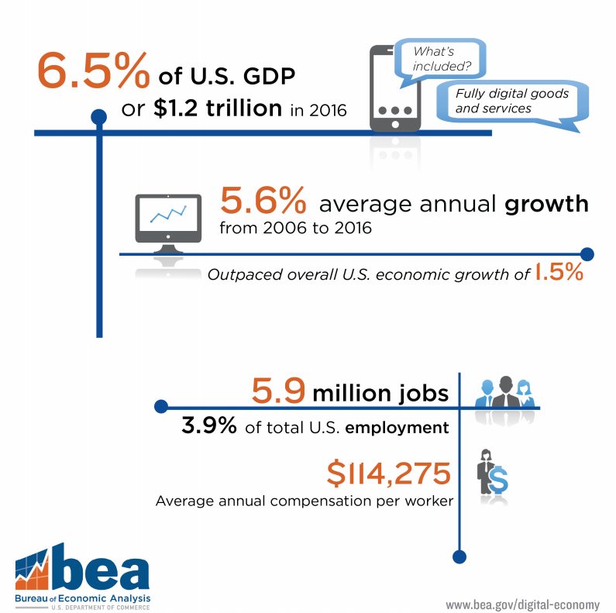
How big is the digital economy?

Slide 11
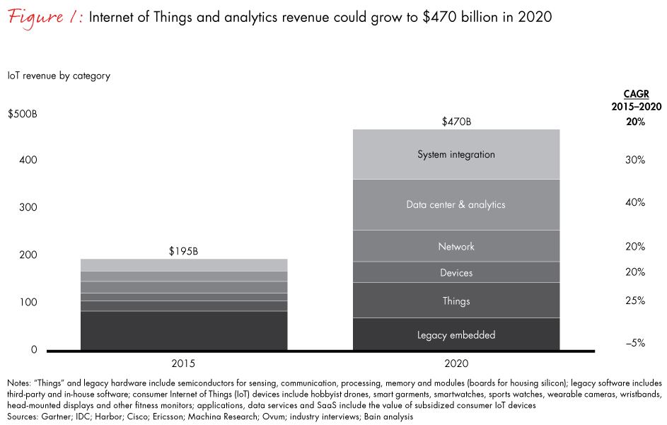

Slide 12
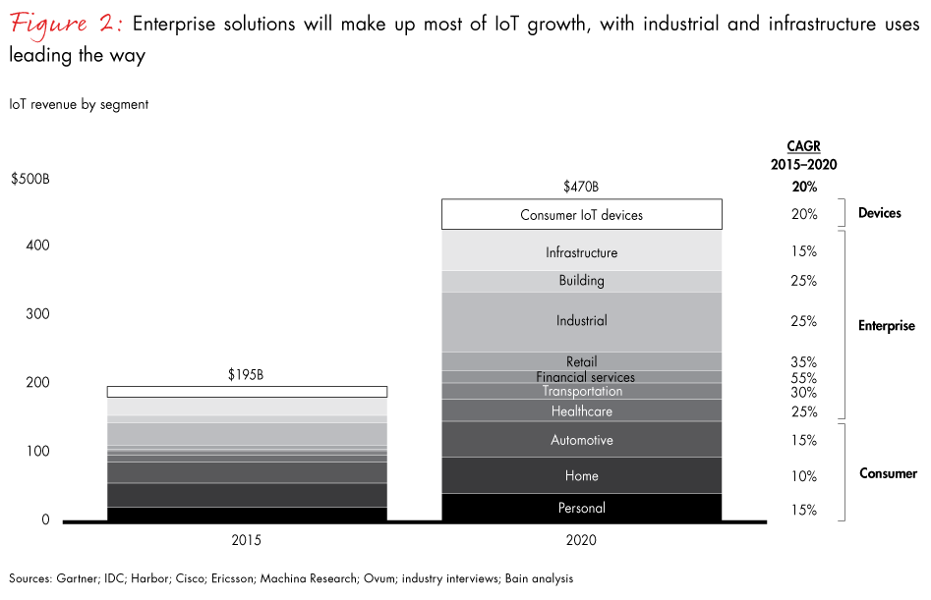

Slide 13
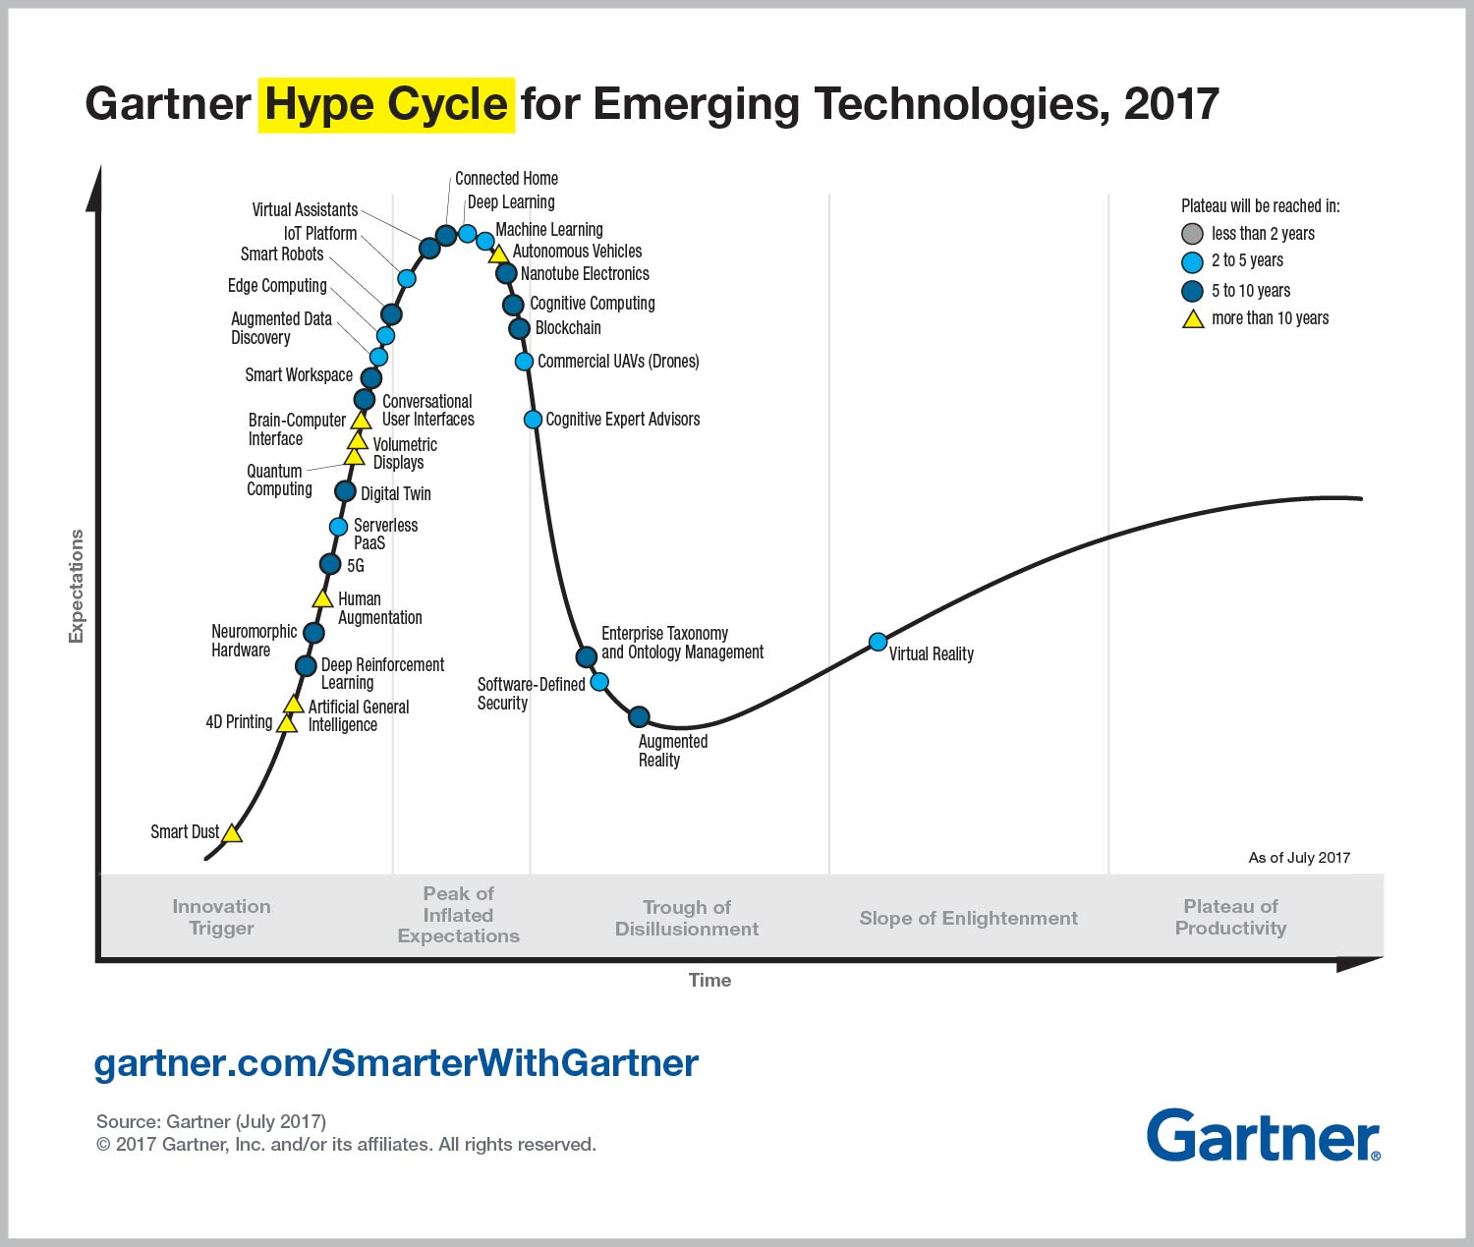

Slide 15
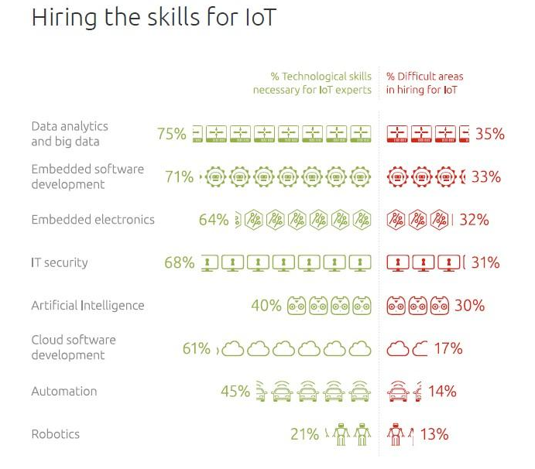
In-Demand Skills
“75% of IoT providers say that data analytics and big data skills are the most in-demand skill set they look for in candidates. Embedded software development expertise is a close second at 71%, followed by IT security (68%) and embedded electronics (64%). Three out of every ten IoT providers (35%) say that finding candidates with data analysis and big data expertise is the most difficult to recruit for today. The following graphic compares IoT provider’s perceptions of which technical skills are necessary for IoT experts to have versus the difficulty of hiring for these skill sets.”
Source: Big Data & Analytics Is The Most Wanted Expertise By 75% Of IoT Providers by Louis Columbus
https://www.forbes.com/sites/louiscolumbus/2017/08/21/big-data-analytics-is-the-most-wanted-expertise-by-75-of-iot-providers/
Source: Internet of Things Business Report, Defining IOT Business Models

Slide 16
IOT Related Job Issues
Overall, 68% of vendors developing IoT solutions are struggling to find and recruit employees with relevant IoT expertise.
Additional skill sets in demand today include embedded software development (33%), embedded electronics (32%), expertise in IT security (31%) and an understanding of Artificial Intelligence (AI) (30%).
Source: Big Data & Analytics Is The Most Wanted Expertise By 75% Of IoT Providers by Louis Columbus
https://www.forbes.com/sites/louiscolumbus/2017/08/21/big-data-analytics-is-the-most-wanted-expertise-by-75-of-iot-providers/

Slide 17
Job Title or Area | Skills Needed
Design Stage – Planning physical layouts and materials | -BIM or CAD software – requires proficiency with software requirements. Mainly design software – training course or on the job BIM training.
Prefab stage - tracking and preparation of materials – estimating, labeling, and packaging processes | -RFID labeling, inventory, quality check on data – basic training (integrate into course or on the job training). -Security of software and data – IT security specialist – training course.
Manufacturer Material Setup – learning how to install and use products | -Need to send contractor to training courses for material installation and handling – training course.
Using IOT enabled devices – collect and monitor data – data warehousing/cloud | - Need to set standards for efficiency for devices – customer and contractor discussion – training course to use device. -Data monitoring – software for data housing – training course. -Custom programming – programmer needed – training course.
IOT Data manipulation – run predictive analytics on data – analyze data – pull reports from data | - Need software analyst – data scientist for BI software analyst –training course (extensive).
Maintenance of IOT – ensure long term usage – power failure - updates | -To update – use training from manufacturer -Data monitoring – analyst training course – certificate.

Slide 18
Prepared by: Amanda Harbison Associate Director of Research National Electrical Contractors Association Amanda.Harbison@necanet.org

